Slide 1
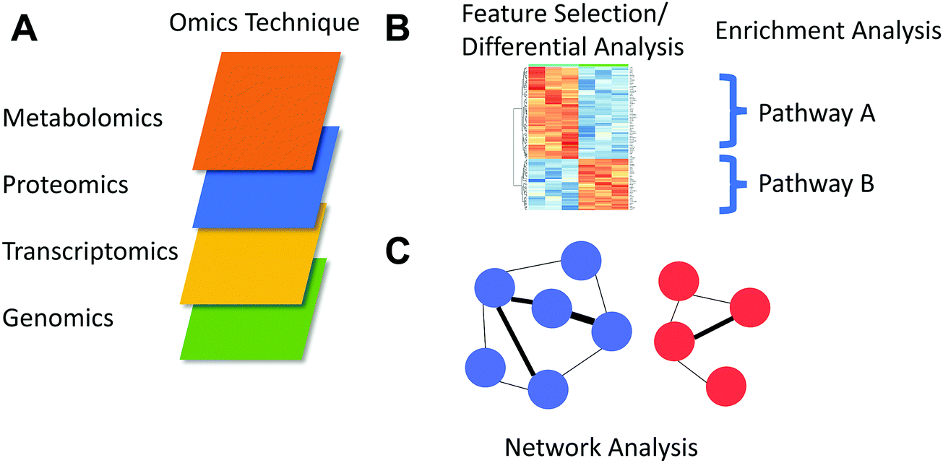
Benchmarking multiomic analysis
Omics
Omics datasets
Feature analysis
Drug response data
Methylation
Transcriptome
Mutation Data
Cool Six
Silvia Fibi-Smetana
Simone Schmid
Jessica O`Callaghan
Ayana Rajagopal
Raheleh Amirkhah
Alison Ross
Network analysis
https://pubs.rsc.org/en/content/articlelanding/2018/mo/c8mo00136g#!divAbstract

Slide 2
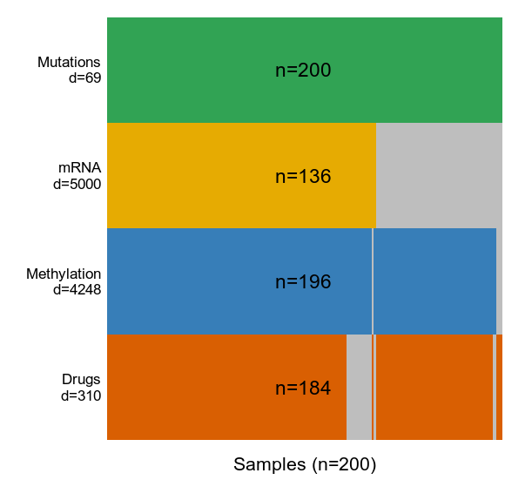
Dataset
200 CLL samples
Omics
Omics datasets
Drug response data
Methylation
Transcriptome
Mutation Data
https://pubs.rsc.org/en/content/articlelanding/2018/mo/c8mo00136g#!divAbstract

Slide 3
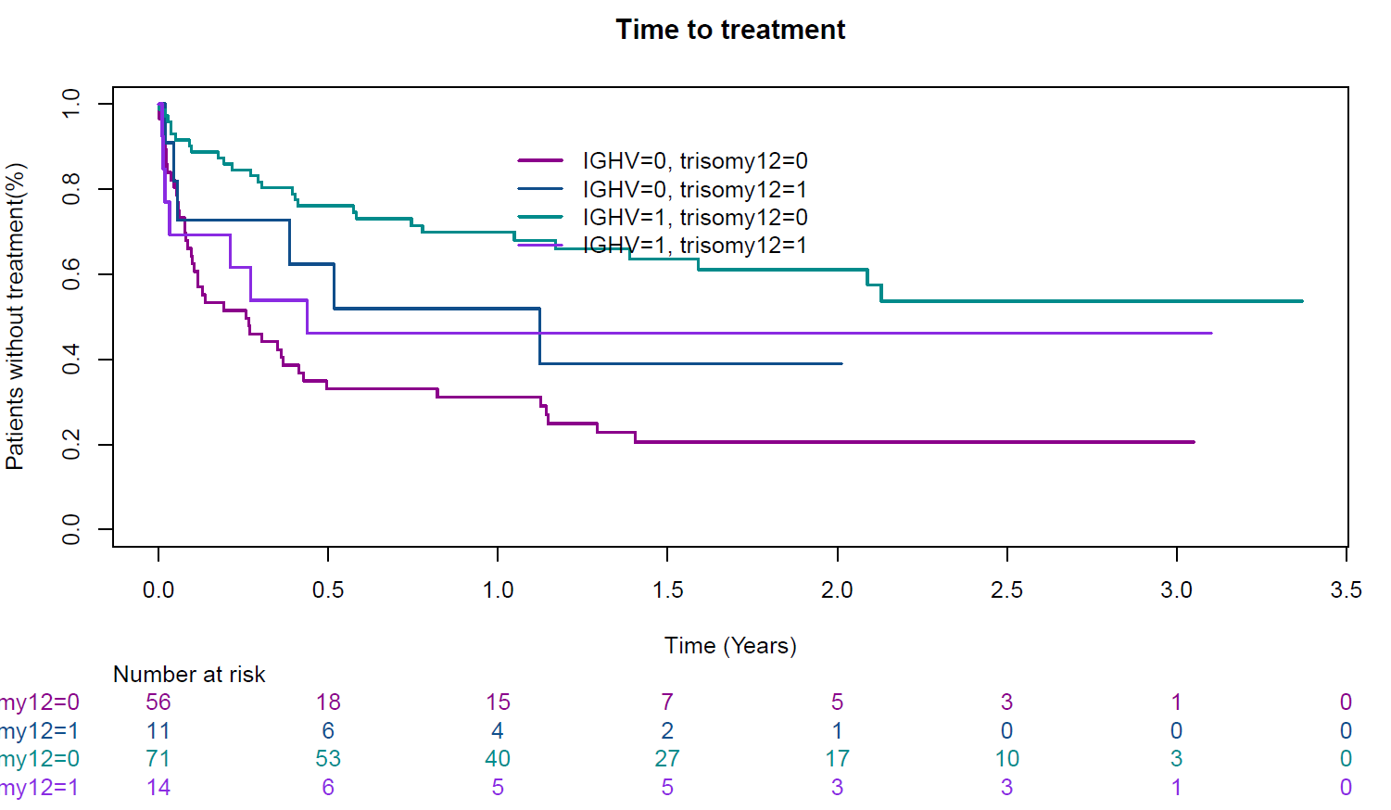
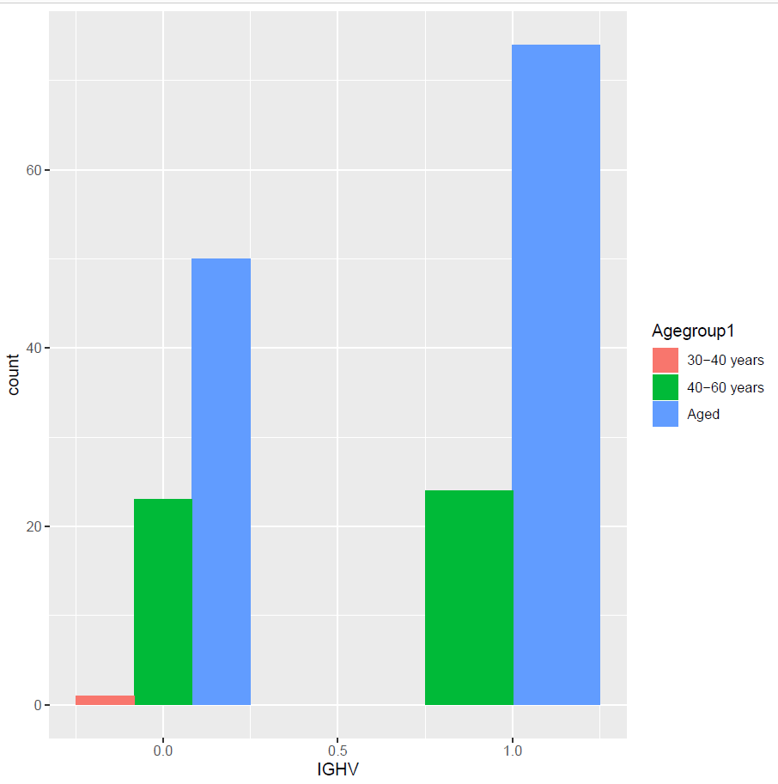
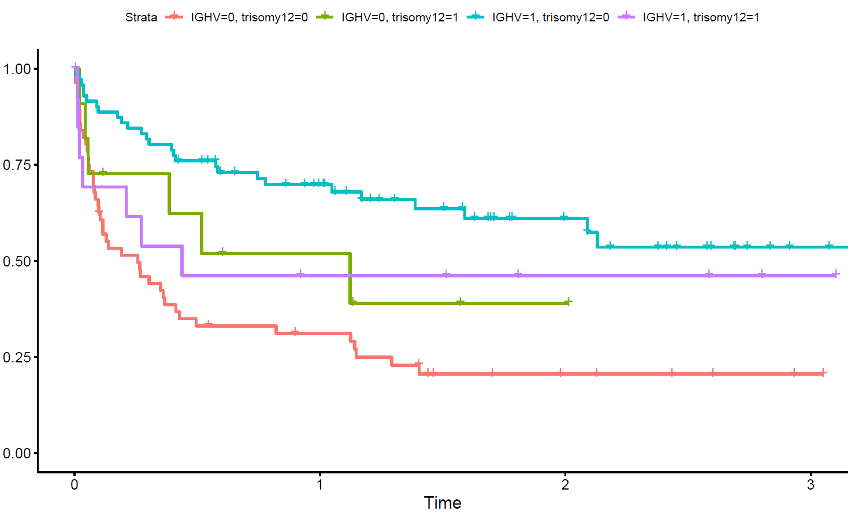
Survival Analysis
Patients without treatment (%)

Slide 4
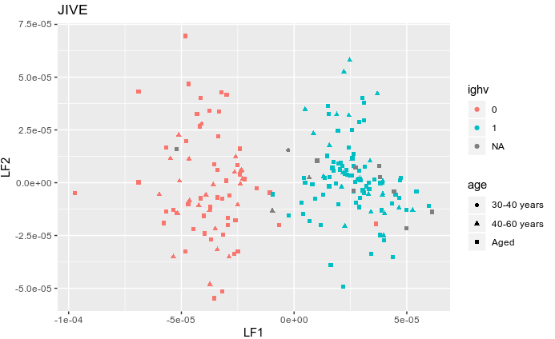
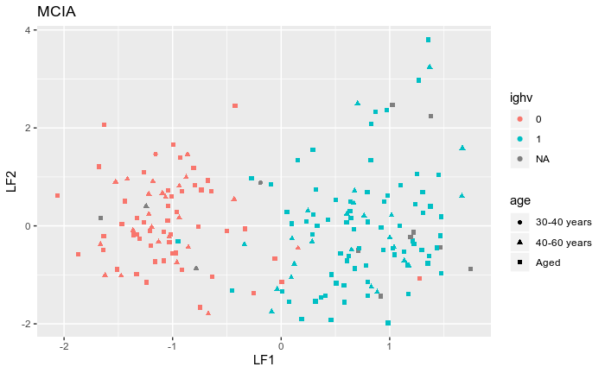
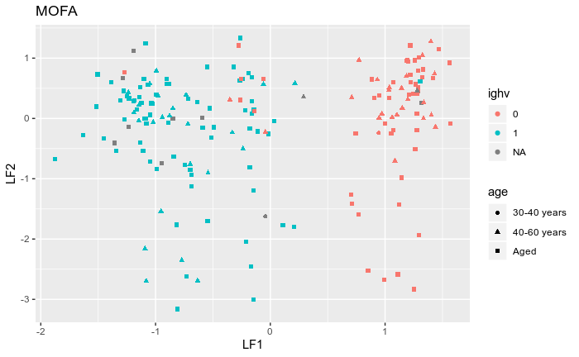
Factor comparison between programs with age and mutation data: stronger correlation with MCIA, JIVE for aged groups

Slide 5
Sample size differences in output - Random/Non random with MOFA
Didn’t work ☺
Non-random sampling; the list of matrices for the MOFA input for samples less than 200 wouldn’t work as an input to create a MOFA object
27 lists of the data frames (Random sampling with replicates) for the random sampling, too computationally heavy (High iterations?)

Slide 6
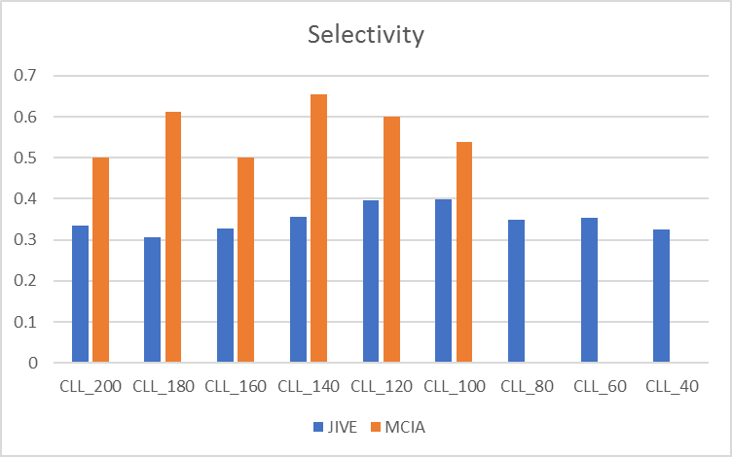
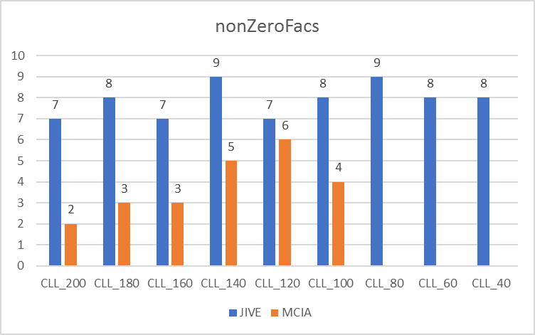
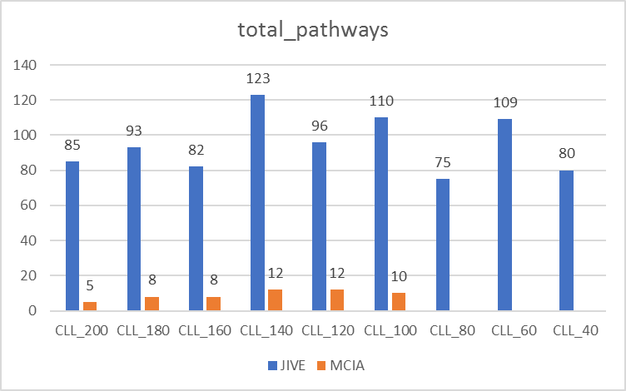
Sample size differences in output - Non-random with JIVE and MCIA
Notes:
Selectivity – number of factors that are uniquely associated with a clinical or biology annotation
nonZeroFacs – factors associated with more than one annotation
<number>

Slide 7

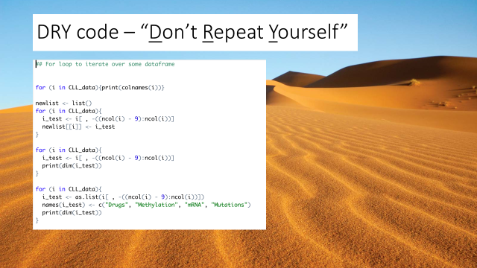
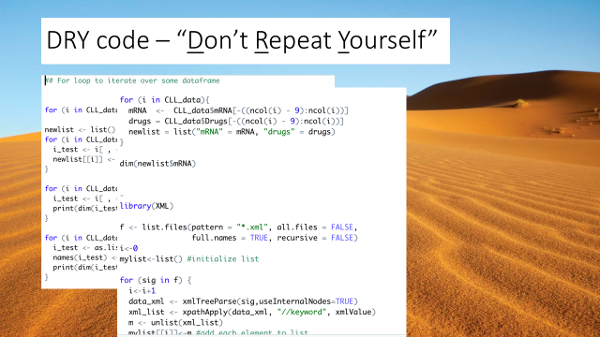
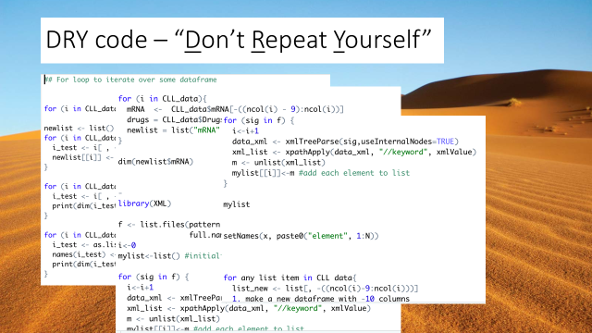
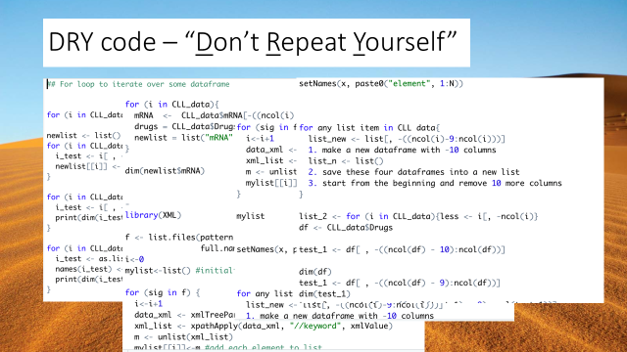
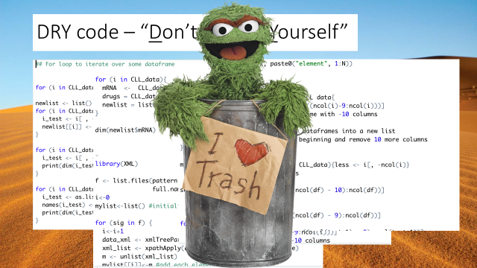
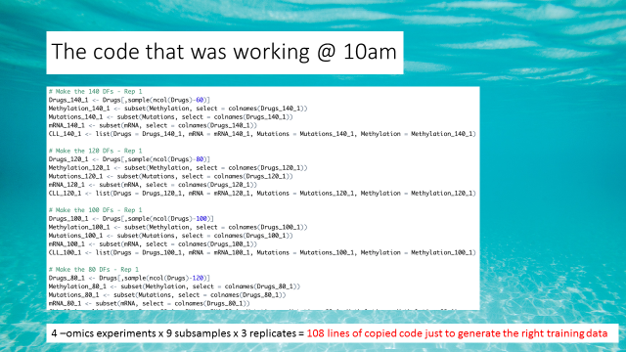
Things learnt
Multiomics techniques
Loops in r
Functions
Challenges
Subtractive sampling didn’t work with n=20, samples left all had NA for one of the variables
MCIA didn’t work with samples below 100 (?)
Packages with different dependences
MOFA didn’t with Gene Symbols but worked with Ensembl IDs

Slide 8
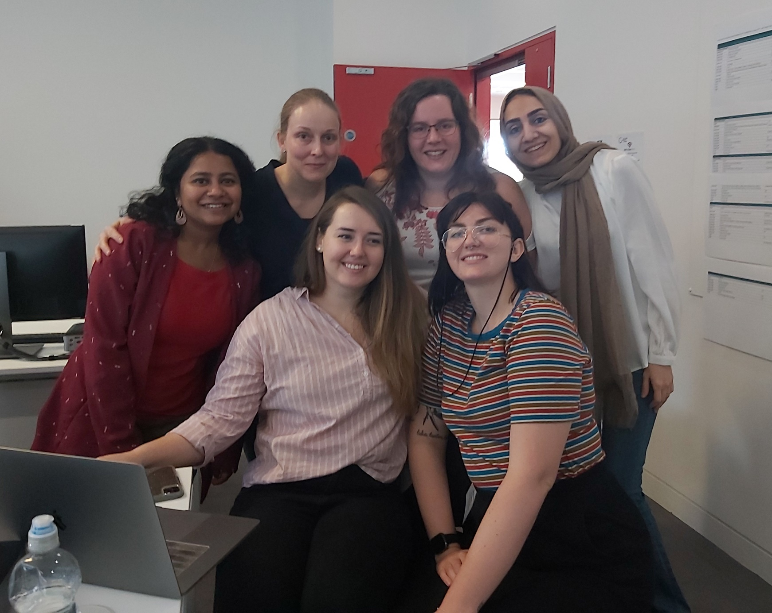
What would come next?
Cool Six – 2020 -2020
Analysing our own data
Writing better pipelines
Minimum complete datasets compared to full dataset with missing variables

